Slide 1

Project Name: T-20 World Cup 2022 Data Analysis
Batch – MIP-ML-10

Slide 2
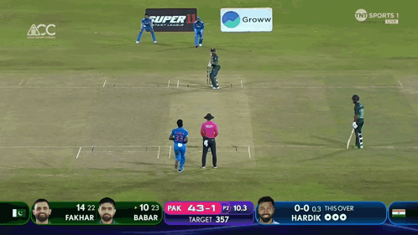
Introduction T-20 world cup 2022
Welcome to the T-20 World Cup 2022 Data Science project. In this endeavor, we'll embark on an exciting journey of comprehensive data analysis, drawing meaningful insights from the action-packed world of T-20 cricket. We'll dive deep into the dataset, explore the nuances of the game, and provide valuable insights and inferences.

Slide 3


Problem Statement:
The T-20 World Cup 2022 dataset provides a goldmine of cricket data, including detailed match statistics, player performances, and game-changing events. Your mission is to unravel the stories hidden within this dataset by:
1. Data Exploration: Delve into the dataset to uncover trends, patterns, and insights. Analyze the performance of teams, players, and key events within the matches.

Slide 4
Problem Statement:
2. In-Depth Analysis: Examine player statistics, including runs, wickets, and over-by-over progress, to understand the dynamics of the game.
3. Event Inference: Identify and analyze critical match events, such as boundaries, wickets, and strategic moments. Uncover the factors that contribute to the success or downfall of a team.

Slide 5
Problem Statement:
4. Performance Evaluation: Evaluate individual and team performances, including standout players, consistent run-scorers, and top wicket-takers. Discover what sets them apart.
5. Statistical Insights: Utilize statistical techniques to gain insights into team strategies, batting, bowling, and match outcomes. Create visualizations that convey the story of the tournament.
.

Slide 6
Dataset Overview:
The dataset contains detailed
information on T-20 World Cup 2022
matches. It includes:
- Match details: Match ID, names of the home and away teams, innings details, over-by-over progress.
- Player statistics: Runs, wickets, and other player-specific details.
- Match events: Boundaries, wickets, retired hurt scenarios, and more.
- Commentary text: Pre-match, in-match, and post-match commentary snippets.
Dataset detail
T-20 World Cup 2022 matches dataset detailed information given.

Slide 7
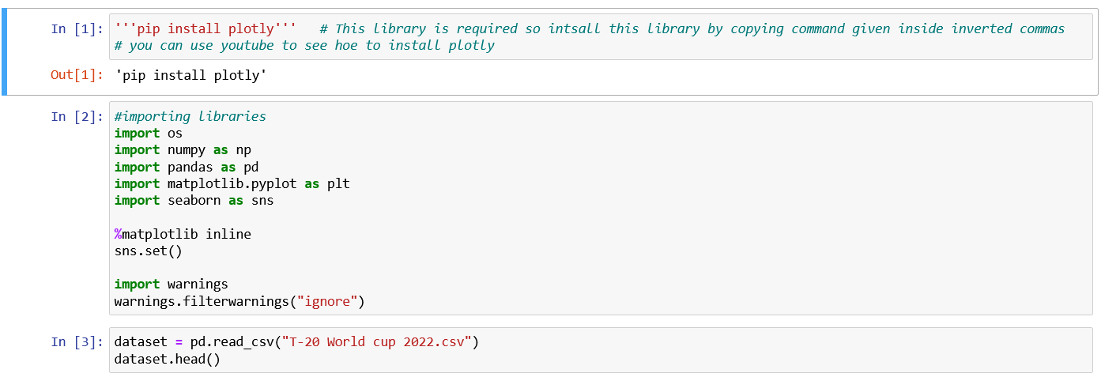
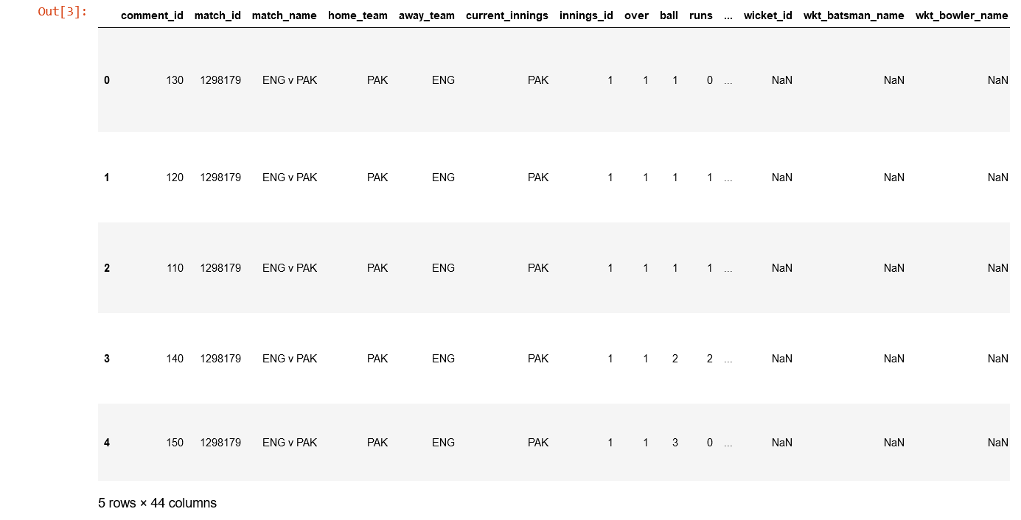
Import Libraries
&
Read Dataset
output

Slide 8
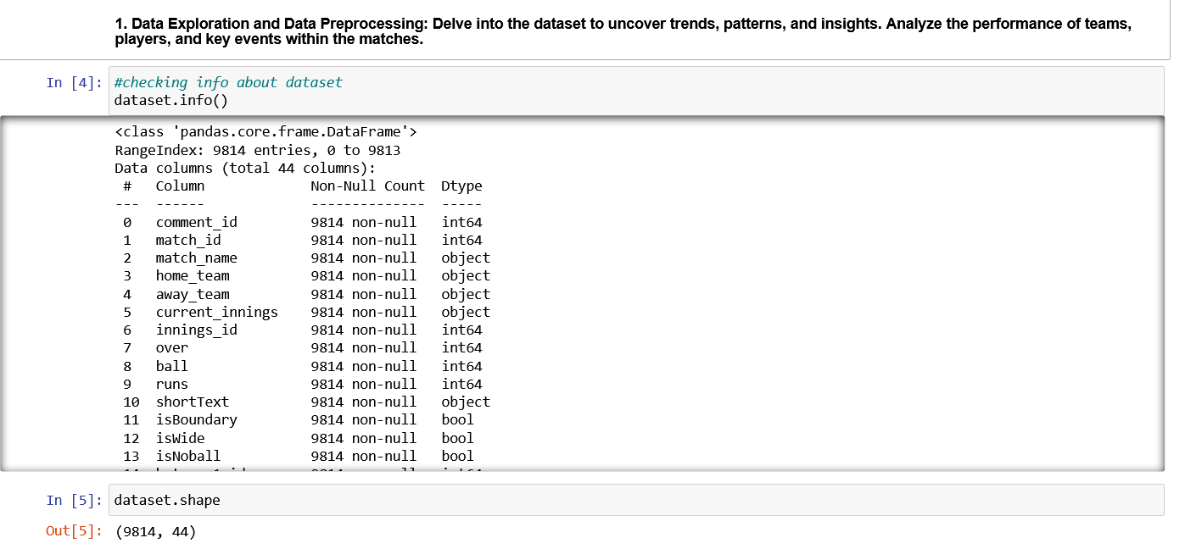

Slide 9
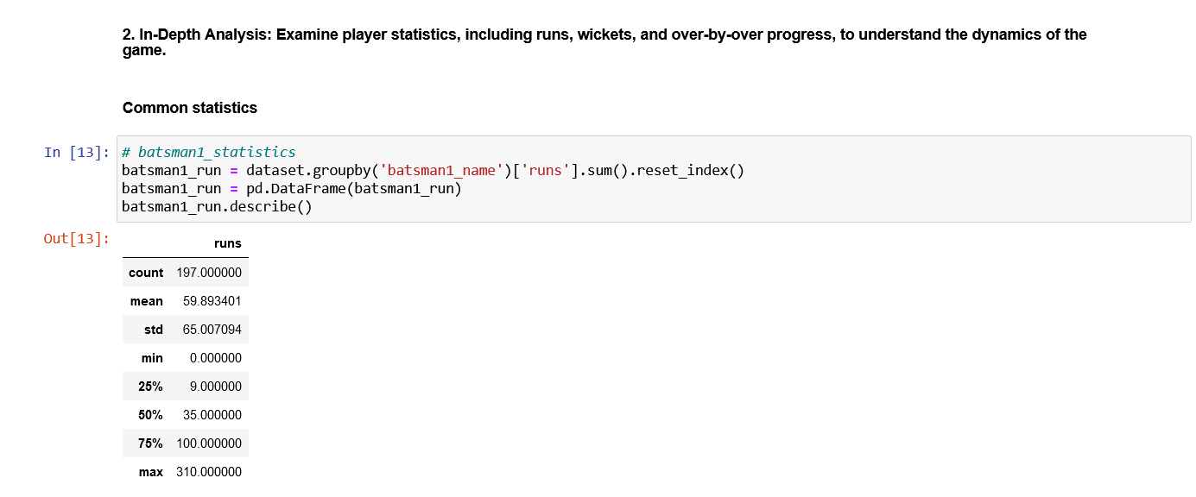

Slide 10
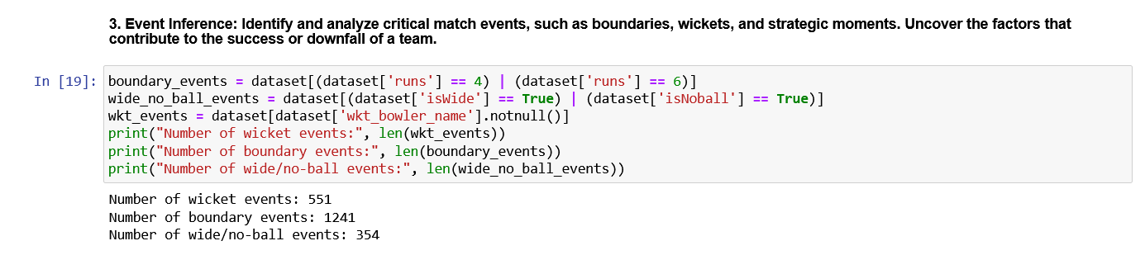

Slide 11
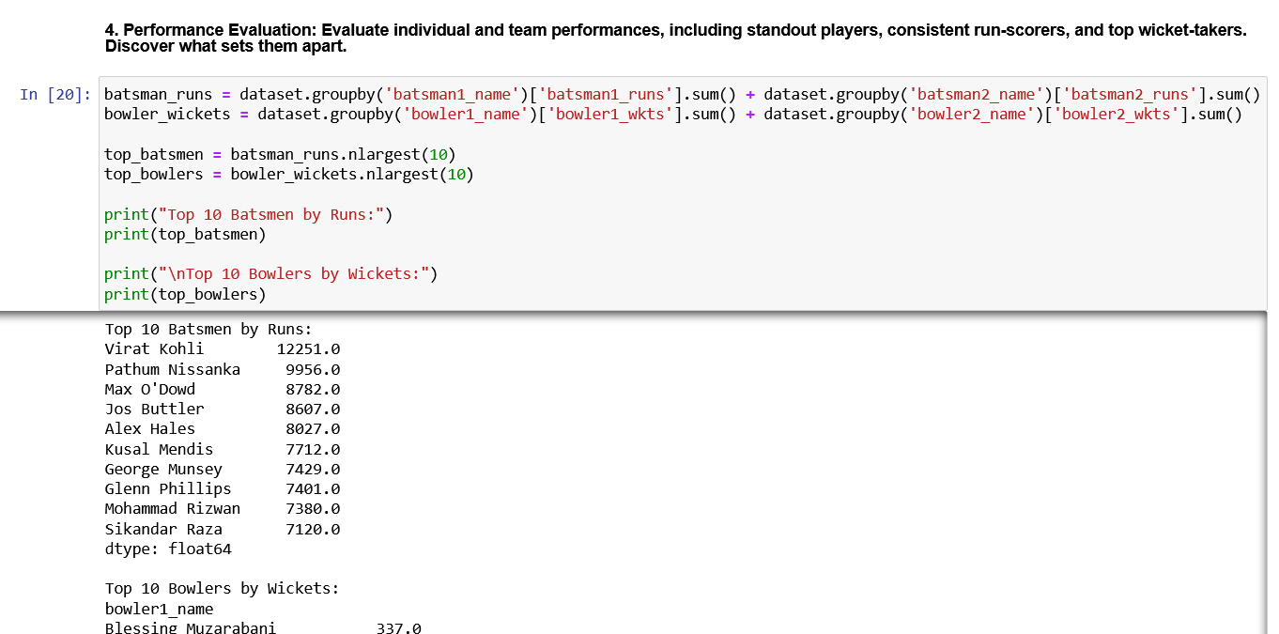

Slide 12
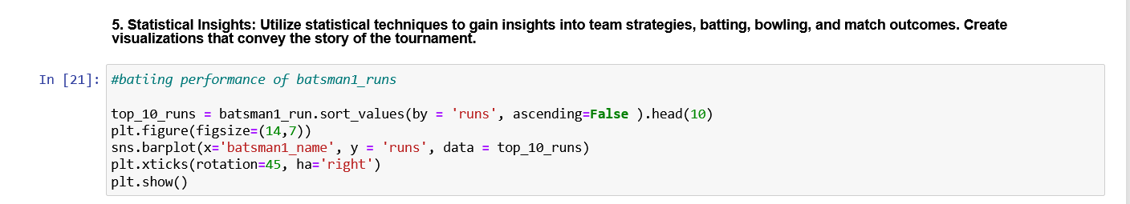
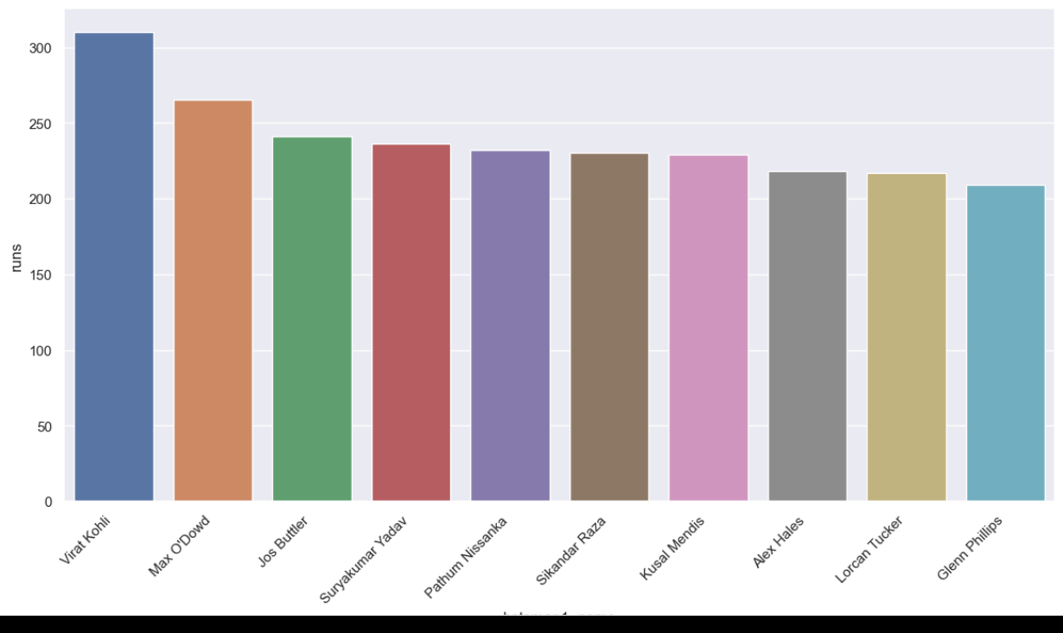
Statistical Insights given in figure

Slide 13
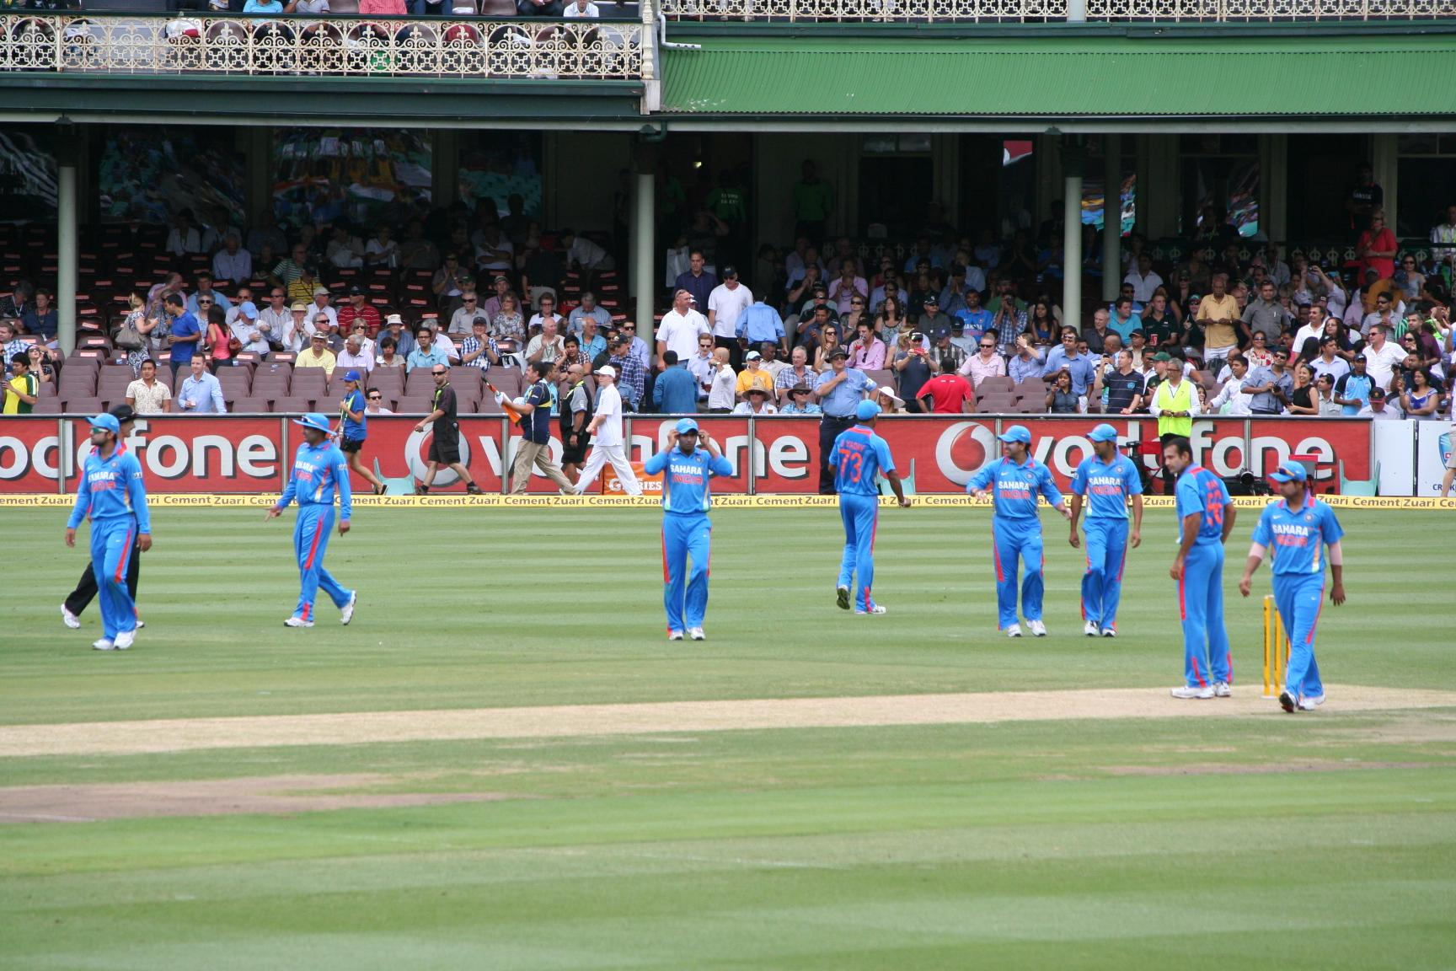
Conclusion
This project presents a thrilling opportunity to analyze real-world T-20 cricket data and draw meaningful insights from it. By the end of this project, you'll have developed strong analytical skills, honed your data analysis techniques, and have the ability to provide a comprehensive understanding of the T-20 World Cup 2022.

